Slide 1
Number class

Slide 2
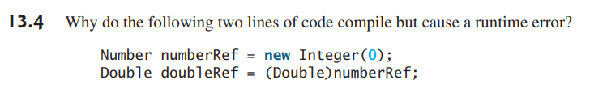
# see code example “E4.java”

Slide 3
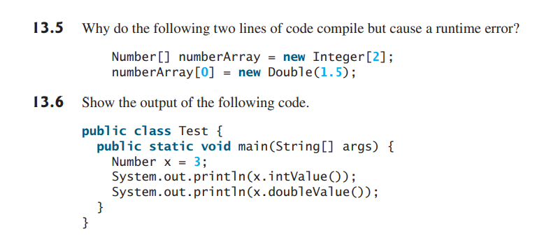
# see code examples “E6.java” and “E7.java”

Slide 4
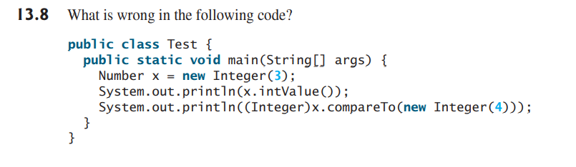
# see code example “E8.java”

